Slide 1
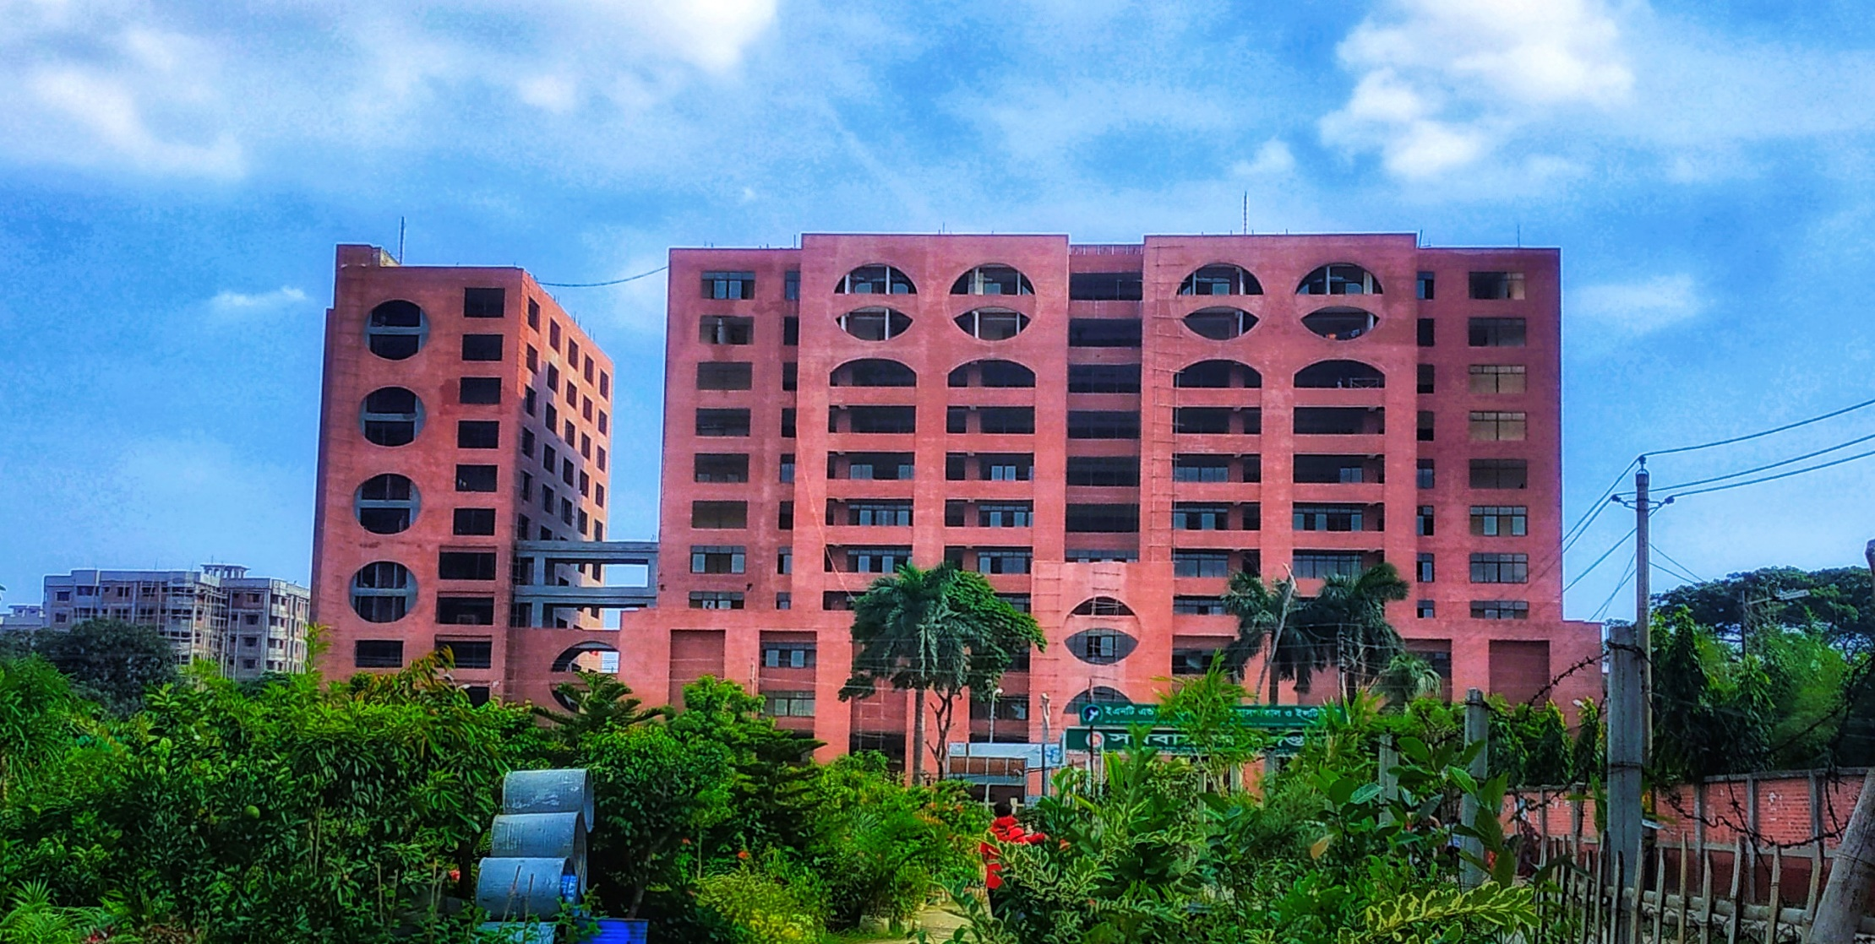
Monthly Statement November’2023
Yellow Unit-1

Slide 2
Statement of COT
Total Working Days | 09
Total Cases Operated | 90

Slide 3
Statement of COT cont.
Upper Limb | 14
Proximal Humerus PHILOS Small DCP | 05 04 01
Shaft of Humerus Posterior Approach | 02 02
Distal Humerus (DHLP) | 02
Shaft of Radius-Ulna Fracture | 04
Distal Radius-Ulna Fracture Volar Locking Plate | 01 01

Slide 4
Statement of COT cont.
Lower Limb | 42
Neck of Femur Fracture Hemiarthroplasty | 03 03
Intertrochanteric Fracture DHS PFN | 07 05 02
Subtrochanteric Fracture PFN | 04 04

Slide 5
Statement of COT cont.
Lower Limb | 42
Shaft of Femur Fracture IMIL Nail SIGN Nail PFN DFN Broad DCP K-Nail | 12 07 01 01 01 01 01
Distal Femur DFLP | 03 03
Tibial Plateau Fracture | 04

Slide 6
Statement of COT cont.
Lower Limb | 42
Shaft of Tibia-Fibula Fracture IMIL Nail | 06 06
Distal Tibial Fracture Distal Tibial Metaphyseal Plate | 01 01
Ankle Fracture | 02

Slide 7
Statement of COT cont.
Special Cases | 34
Spine PLID Cervical Myelopathy | 02 01 01
Acetabulum Fracture | 01
AVN Total Hip Replacement Core Decompression | 04 02 02
Varus Non-union of Fracture Neck of Femur Valgus Osteotomy | 01 01
CPN Injury | 01

Slide 8
Statement of COT cont.
Special Cases | 34
Brachial Plexus Injury | 01
Glenoid Rim Fracture ORIF By Reconstruction & Screws | 01 01
Cubitus Valgus Deformity Corrective Osteotomy | 01 01
Old Elbow Dislocation | 01
Terrible Triad Injury | 01
Giant Cell Tumour Curettage & Biopsy | 01 01

Slide 9
Statement of COT cont.
Special Cases | 34
Exostosis Extra-periosteal Excision | 01 01
Implant Failure Sub-trochanteric Fracture Shaft of Femur Fracture Shaft of Radius-Ulna Fracture | 05 01 02 02
Non-union Ilizarov Limb Reconstruction System (LRS) ORIF | 10 05 01 04

Slide 10
Statement of COT cont.
Special Cases | 34
Biopsy Soft Tissue Mass In Shoulder Osteolytic lesion In Fibula Cystic Lesion In Tibia | 03 01 01 01

Slide 11
Statement of DOT
Total Working Days | 09
Total Case Operated | 98

Slide 12
Statement of DOT
Implant Removal | 13
Ilizarov | 17
Osteomyelitis | 04
Flap Coverage | 19
Others | 45

Slide 13
Statement of Emergency
Total Working Days | 05
Total Patients at Emergency | 593
Total Patients Admitted | 243

Slide 14
Statement of EOT
Total Working Days | 05
Total Patients at EOT | 203

Slide 15
Statement of OPD
Total Working Days | 04
Total Patients New Patient Old Patient | 967 778 189
Total Patients Admitted | 19

Slide 16
Death: Nil
Complications Until Discharge: Nil

Slide 17
Thank You

