Slide 1
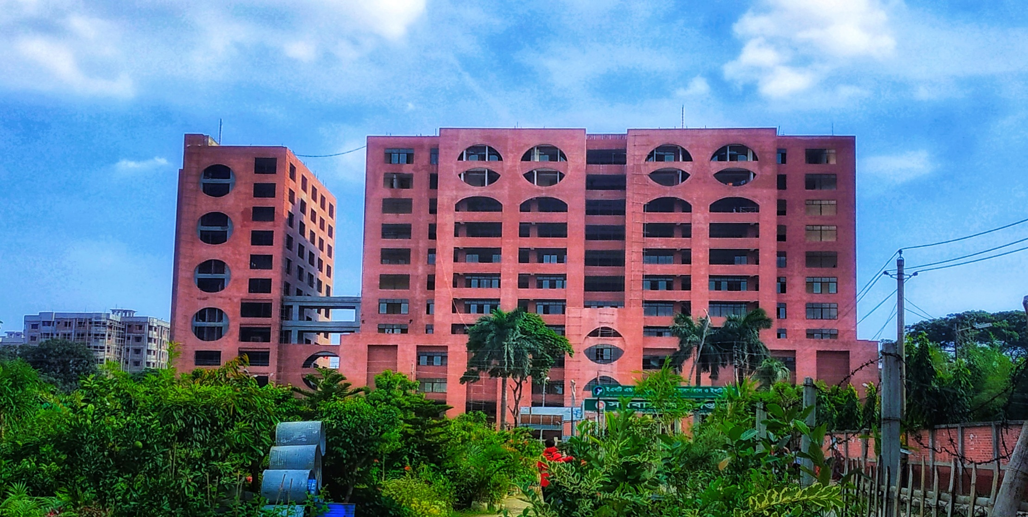
Monthly Statement November’2023
Yellow Unit-2

Slide 2
Statement of COT
Total Working Days | 09
Total Cases Operated | 76

Slide 3
Statement of COT cont.
Upper Limb | 14
Proximal Humerus PHILOS Narrow DCP | 06 04 02
Shaft of Humerus Posterior Approach | 02 02
Shaft of Radius-Ulna Fracture | 04
Distal Radius-Ulna Fracture Volar Locking Plate | 02 02

Slide 4
Statement of COT cont.
Lower Limb | 38
Neck of Femur Fracture Hemiarthroplasty | 05 05
Intertrochanteric Fracture DHS PFN | 07 05 02
Subtrochanteric Fracture PFN DCS | 04 03 01

Slide 5
Statement of COT cont.
Lower Limb | 38
Shaft of Femur Fracture IMIL Nail DFN Broad DCP K-Nail | 12 07 01 01 01
Distal Femur DFLP | 01 01
Tibial Plateau Fracture | 02

Slide 6
Statement of COT cont.
Lower Limb | 38
Shaft of Tibia-Fibula Fracture IMIL Nail | 04 04
Distal Tibial Fracture Distal Tibial Metaphyseal Plate | 01 01
Ankle Fracture | 02

Slide 7
Statement of COT cont.
Special Cases | 24
Spine PLID Burst # | 05 02 03
AVN Core Decompression | 01 01
Giant Cell Tumour Curettage & Biopsy | 01 01

Slide 8
Statement of COT cont.
Special Cases | 24
Exostosis Extra-periosteal Excision | 01 01
Implant Failure Shaft of Femur Fracture Shaft of Radius-Ulna Fracture | 06 02 04
Non-union Ilizarov ORIF | 10 07 03

Slide 9
Statement of DOT
Total Working Days | 09
Total Case Operated | 65

Slide 10
Statement of DOT
Implant Removal | 05
Ilizarov | 04
Osteomyelitis | 01
Flap Coverage | 19
Others | 36

Slide 11
Statement of Emergency
Total Working Days | 05
Total Patients at Emergency | 527
Total Patients Admitted | 203

Slide 12
Statement of EOT
Total Working Days | 05
Total Patients at EOT | 181

Slide 13
Statement of OPD
Total Working Days | 04
Total Patients New Patient Old Patient | 736 587 149
Total Patients Admitted | 13

Slide 14
Death: Nil
Complications Until Discharge: Nil

Slide 15
Thank You

