Slide 1
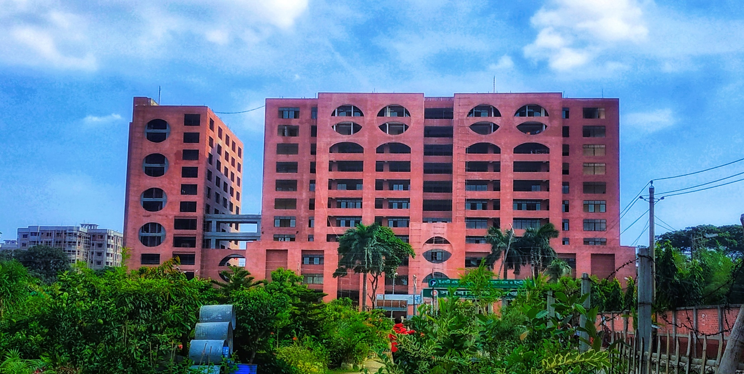
Monthly Statement November’2023
Violet 1

Slide 2
Statement of COT
Total Working Days | 09
Total Cases Operated | 93

Slide 3
Statement of COT cont.
Upper Limb | 14
Proximal Humerus PHILOS | 04 04
Shaft of Humerus | 02
Distal Humerus (DHLP) | 03
Shaft of Radius-Ulna Fracture | 03
Distal Radius-Ulna Fracture Volar Locking Plate | 02 02

Slide 4
Statement of COT cont.
Lower Limb | 42
Neck of Femur Fracture Hemiarthroplasty | 03 03
Intertrochanteric Fracture DHS PFN | 07 04 03
Subtrochanteric Fracture PFN | 04 04

Slide 5
Statement of COT cont.
Lower Limb | 42
Shaft of Femur Fracture IMIL Nail PFN DFN Broad DCP K-Nail | 12 07 01 02 01 01
Distal Femur DFLP | 03 03
Tibial Plateau Fracture | 04

Slide 6
Statement of COT cont.
Lower Limb | 42
Shaft of Tibia-Fibula Fracture IMIL Nail | 04 04
Distal Tibial Fracture Distal Tibial Metaphyseal Plate | 02 02
Ankle Fracture | 03

Slide 7
Statement of COT cont.
Special Cases | 37
Spine PLID Cervical Myelopathy Burst fracture | 02 01 03
Acetabulum Fracture | 05
AVN Total Hip Replacement | 05 05
PFN with TSP | 02
CPN Injury | 01

Slide 8
Statement of COT cont.
Special Cases | 37
Fracture NOF-fixation by FNS | 02
Sacral bone fracture- Spino pelvic fixationv | 01
Fracture NOF- Primary THR | 02
Ruptured tendo achilles | 01
Terrible Triad Injury | 02
Haglund deformity | 01

Slide 9
Statement of COT cont.
Special Cases | 37
Exostosis over scapula Extra-periosteal Excision | 01 01
Implant Failure Shaft of humerus Fracture Shaft of Femur Fracture Shaft of Radius-Ulna Fracture | 04 01 02 01
Non-union Ilizarov ORIF | 04 03 01

Slide 10
Statement of DOT
Total Working Days | 09
Total Case Operated | 55

Slide 11
Statement of Emergency
Total Working Days | 04
Total Patients at Emergency | 451
Total Patients Admitted | 183

Slide 12
Statement of EOT
Total Working Days | 04
Total Patients at EOT | 129

Slide 13
Statement of OPD
Total Working Days | 05
Total Patients New Patient Old Patient | 1157 879 278
Total Patients Admitted | 43

Slide 14
Death: Nil
Complications Until Discharge: Nil

Slide 15
Thank You

